Slide 1
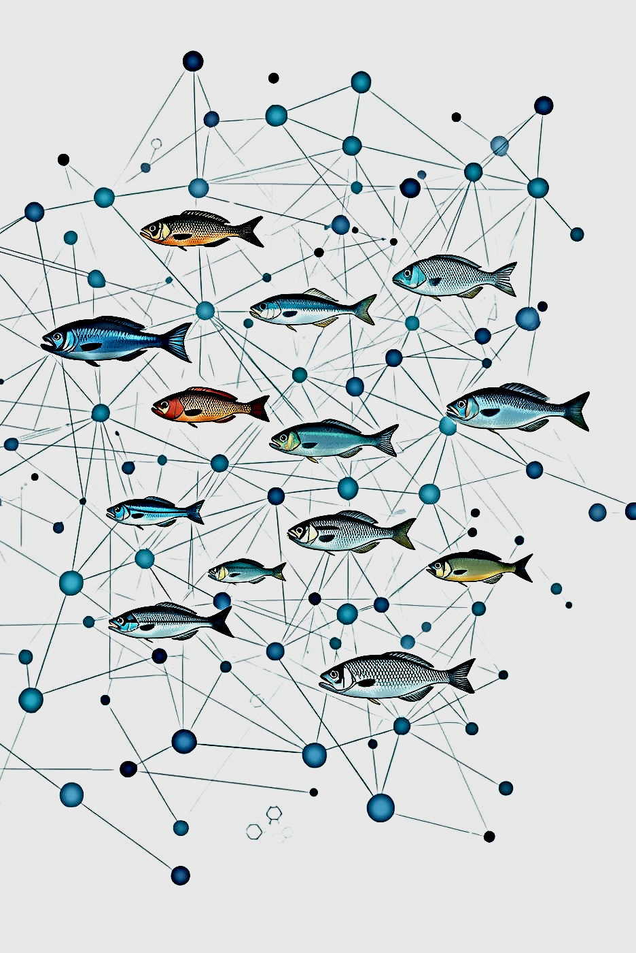

AI Fish Species Recognition

Slide 2
Project Overview
Identifying fish species from images is a challenging fine-grained classification task, as many species share similar shapes, colors, and textures.
This project uses convolutional neural networks to automatically classify fish images into multiple species

Slide 3
Project Timeline
Data Acquisition
And Cleaning
Model Training
Evaluation
Gathering and preparing fish images dataset
Training the CNN on preprocessed data
Assessing model performance and accuracy

Slide 4
Dataset Overview of Fish Species
Collection and Characteristics of Images
This project uses a publicly available fish image dataset from Kaggle consisting of labeled images organized by species has
9 different fish species
~1000 images per class after augmentation
The dataset was split into Training (70%), Validation (15%), and Test (15%) sets.
Data leakage caused by duplicate images across splits was identified and resolved to ensure reliable model evaluation.

Slide 5
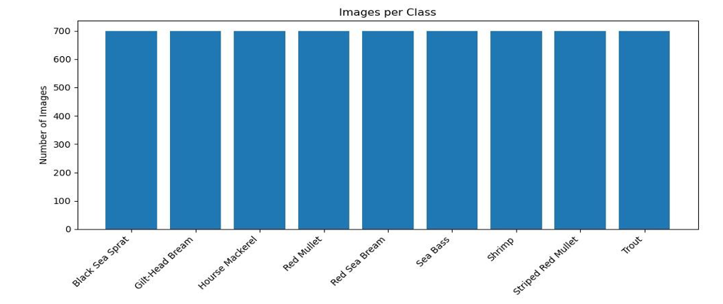
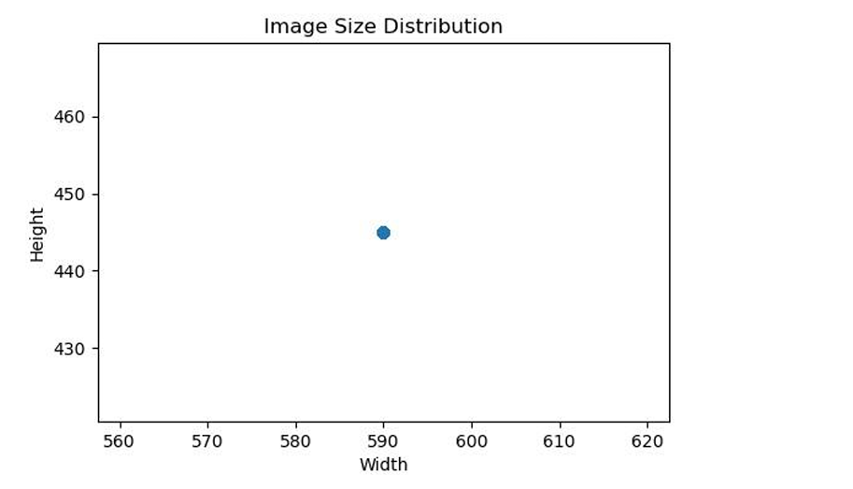
Exploratory Data Analysis (EDA)
EDA was performed to understand dataset structure and quality before training. The main checks included:
Number of classes and images per class.
Class balance
Image size distribution
Corrupted images detection

Slide 6
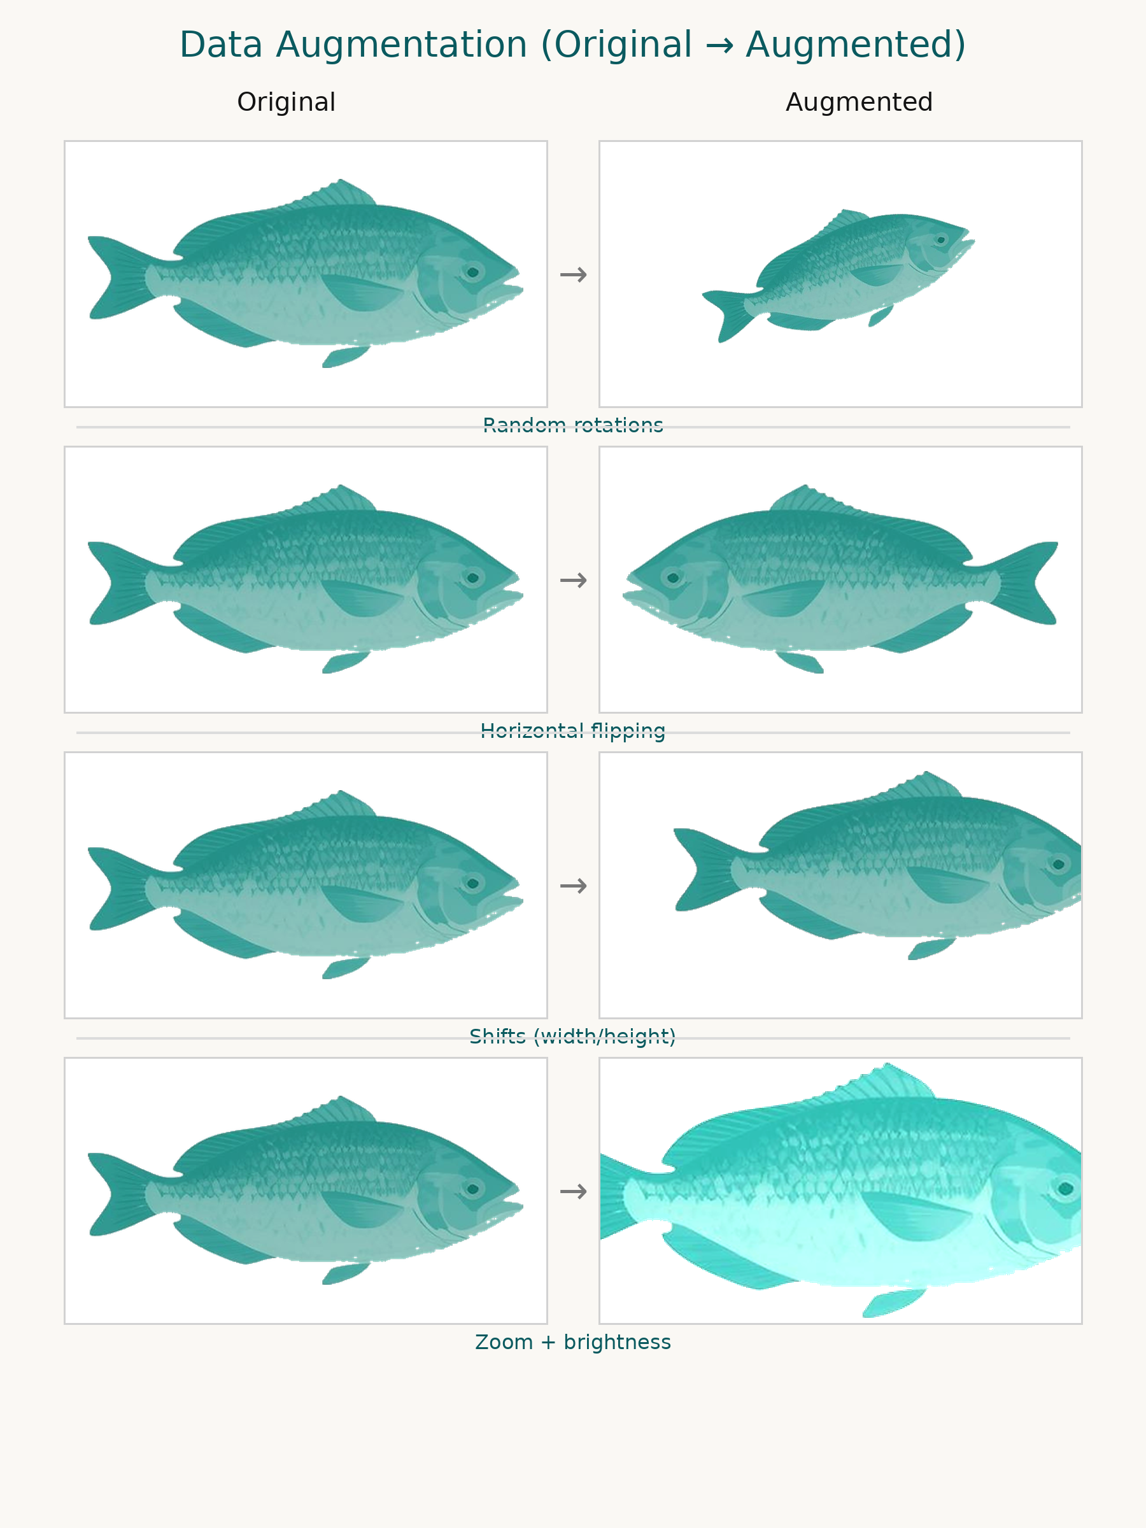
Data Preprocessing
Resize all images to 128 × 128
Normalize pixel values to [0, 1]
Apply data augmentation only on the training set (Random rotations , Horizontal flipping , Shifts (width/height) , Zoom and Brightness adjustments )
Remove corrupted or unreadable images

Slide 7


CNN Models
Architectures
Layers
Activation
Pooling
Baseline CNN trained from scratch
Mobile Net using transfer learning
Same dataset and evaluation setup for fair comparison
Convolutional layers for feature extraction
Fully connected layers for classification
Dropout layers for regularization
SoftMax output layer for multi-class prediction
ReLU activation used in convolutional layers
Introduces non-linearity and improves learning capacity
SoftMax activation used in the output layer
Max pooling after convolution
Reduces size while preserving key features

Slide 8
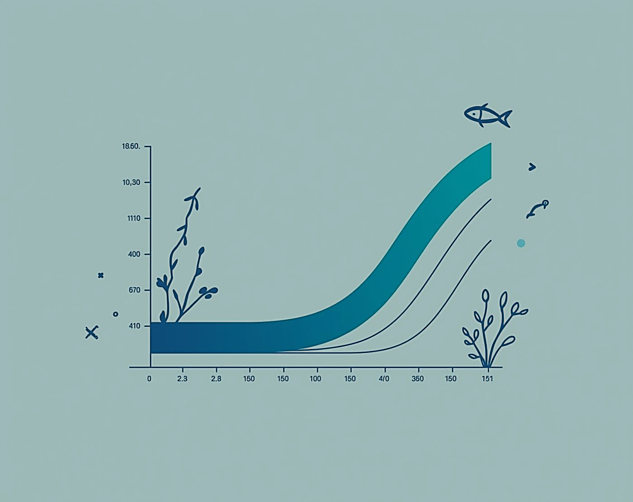
Training Process and Hyperparameter Tuning
⚙️ Optimizer: Adam
📉 Loss Function: Categorical Cross-Entropy
📦 Batch Size: 32
🔁 Epochs: 30
⏹️ Early Stopping to prevent overfitting
💾 Model Checkpoint to save the best model

Slide 9
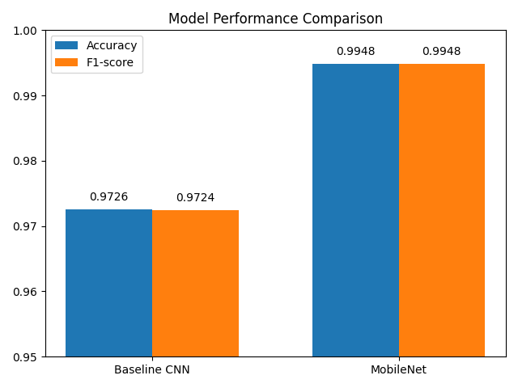
Evaluation Metrics in Fish Recognition
Accuracy measures the percentage of correct predictions on the test set. While it provides a useful overall performance indicator, it does not fully capture class-level confusions.
Precision: proportion of correctly predicted samples for class
Recall: proportion of true samples correctly identified
F1-score: harmonic mean of precision and recall
📊 Baseline CNN Accuracy: 0.9726
🚀 Mobile Net Accuracy: 0.9948
📈 Baseline CNN F1-score: 0.9724
🏆 Mobile Net F1-score: 0.9948
MobileNet outperforms the baseline CNN in both accuracy and F1-score.

Slide 10
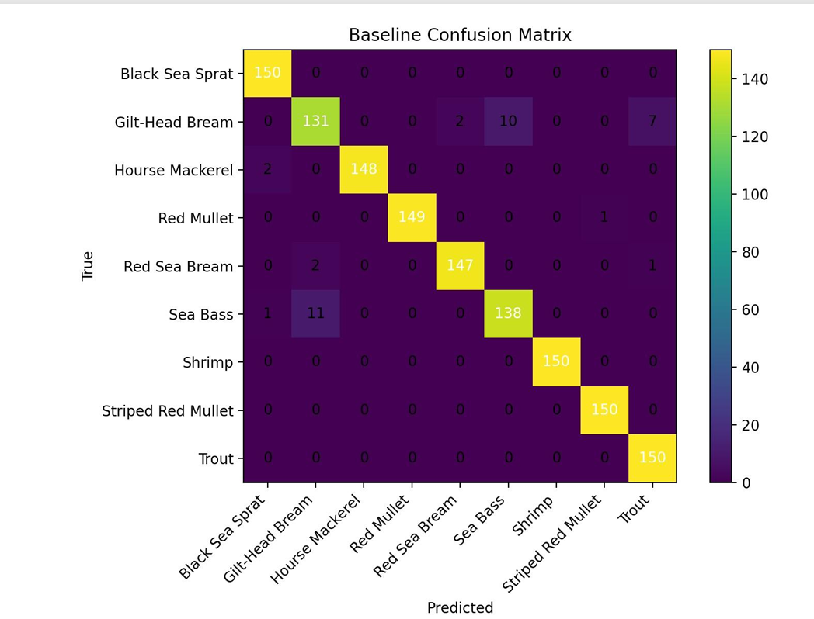
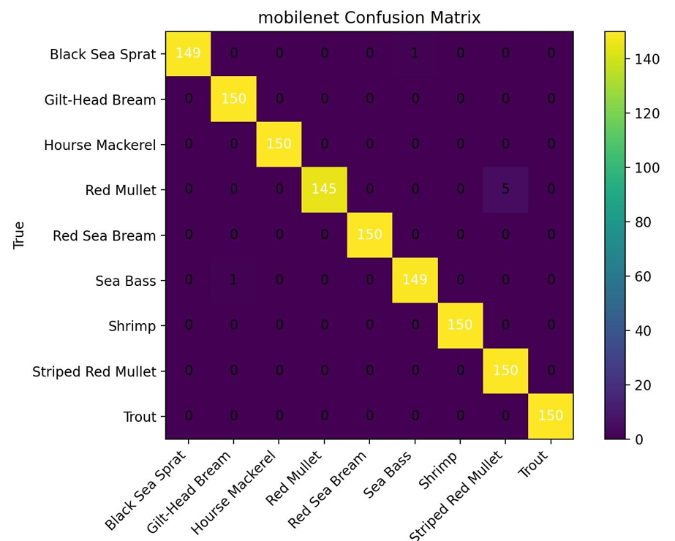
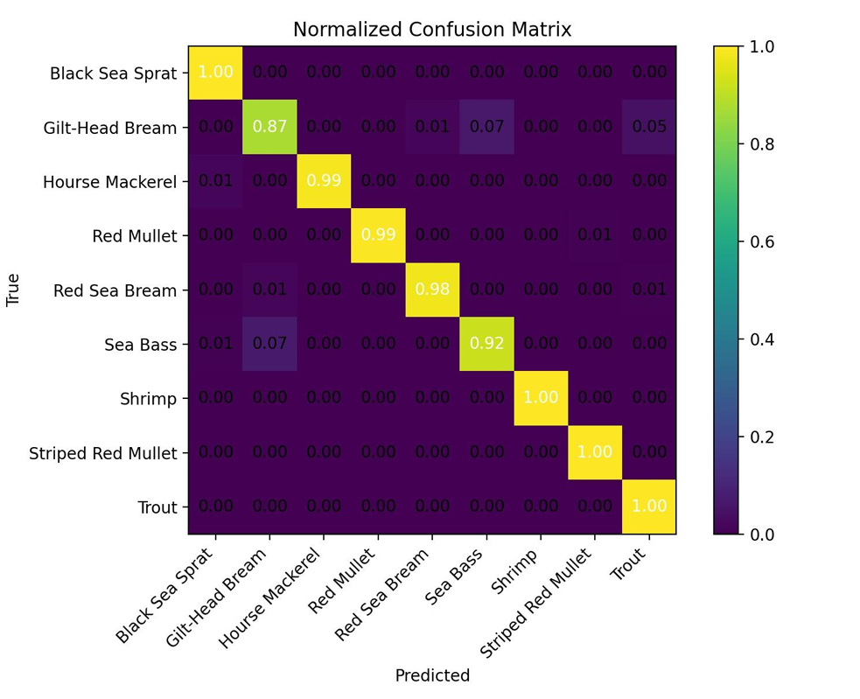
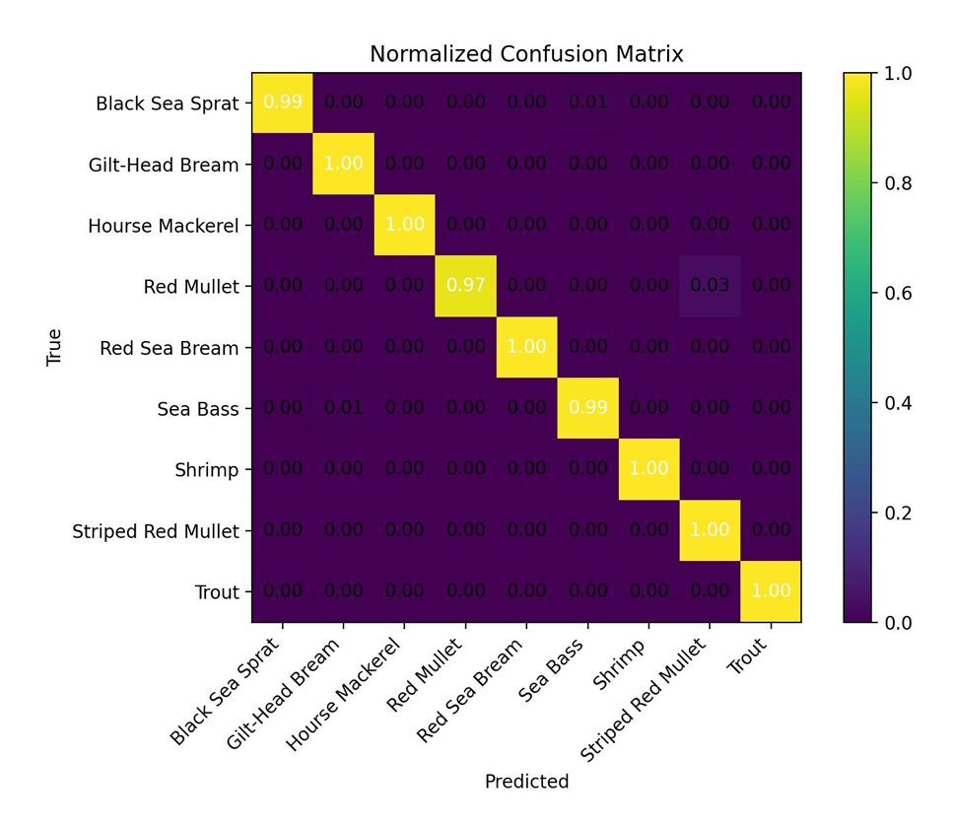
Confusion Matrix

Slide 11
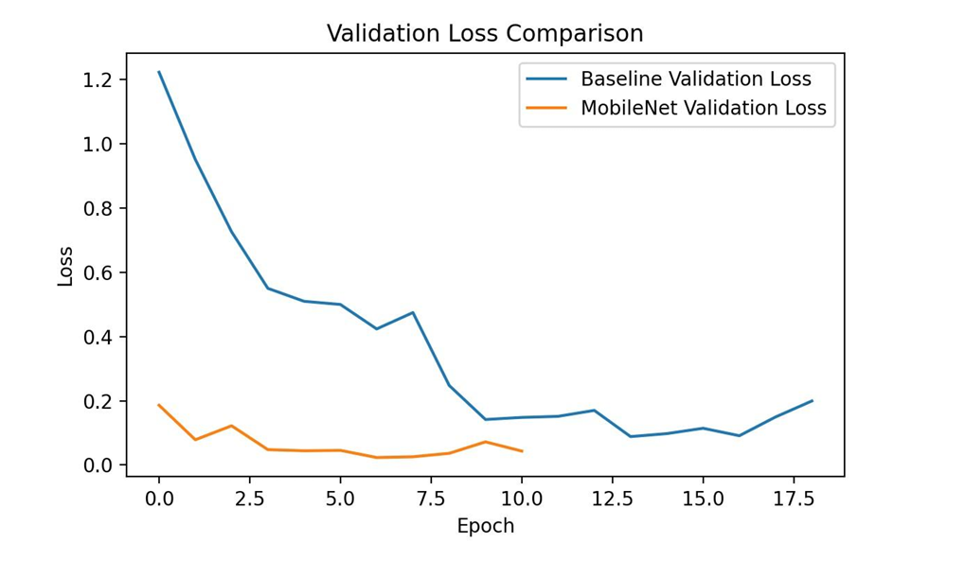
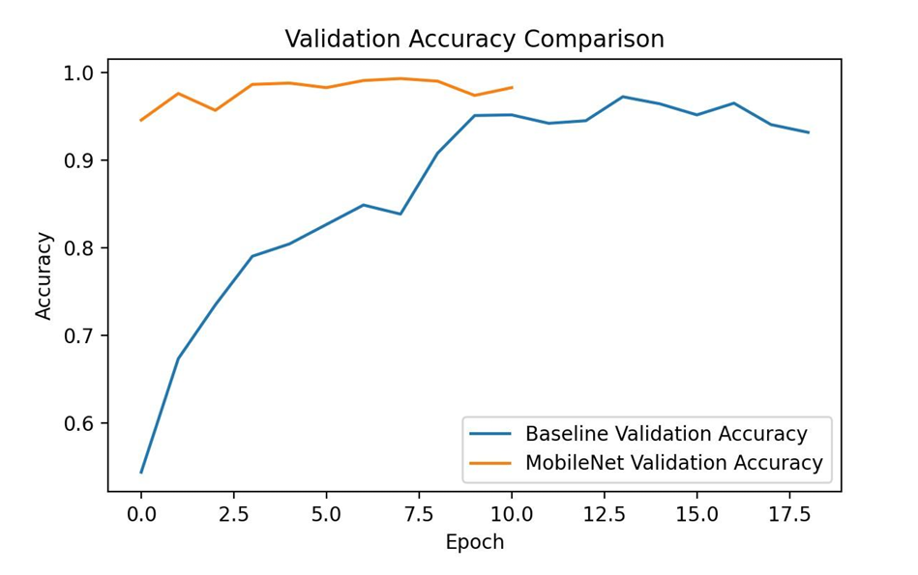
Results and Analysis
Performance on various fish species
Both models achieved strong performance on the test set. The Mobile Net model consistently outperformed the baseline CNN in terms of accuracy and F1-score, demonstrating better generalization and more robust feature extraction through transfer learning.

Slide 12
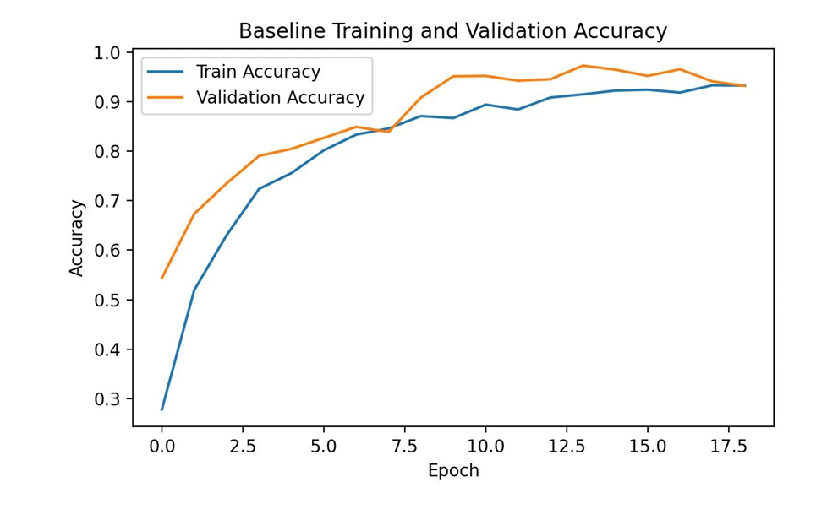
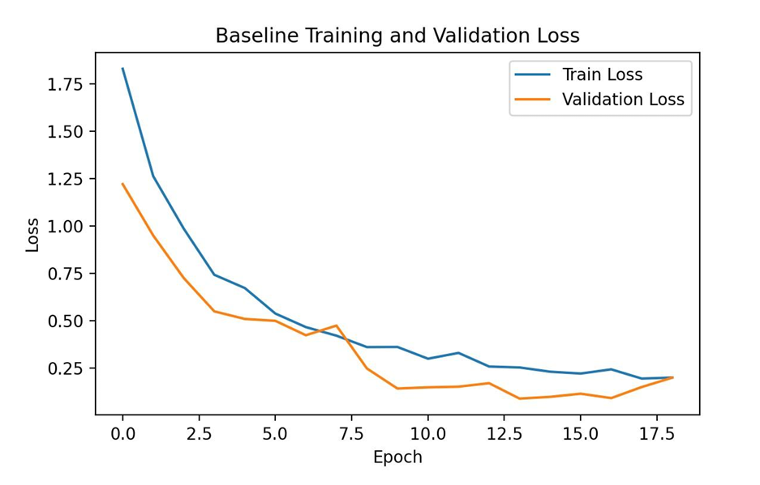
Baseline Summary
Performance on various fish species
• Strength: Simple, interpretable, validates pipeline.
• Performance:

Slide 13
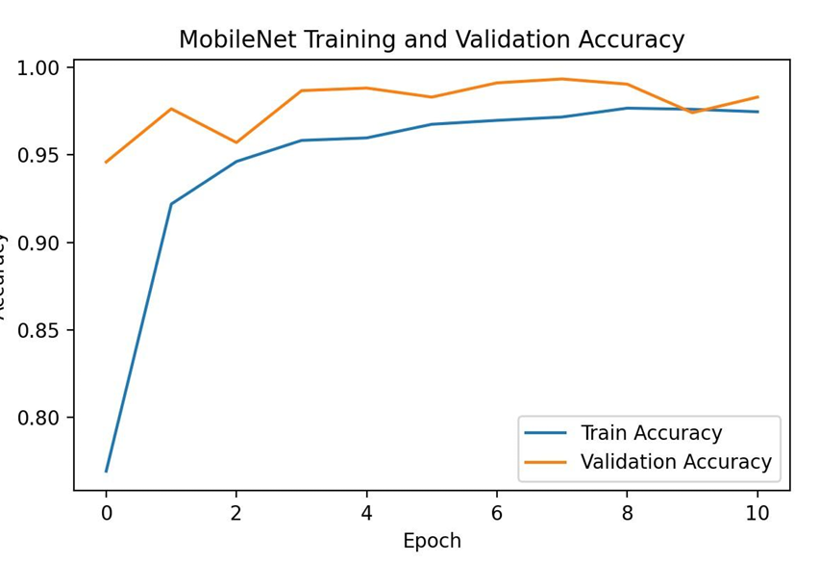
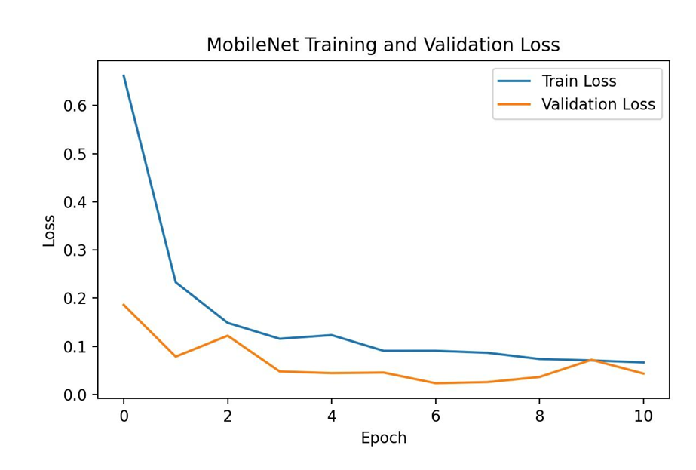
Mobile Net Summary
Performance on various fish species
•Strength: Uses pretrained features, faster convergence, typically better generalization. .
• Performance:

Slide 14
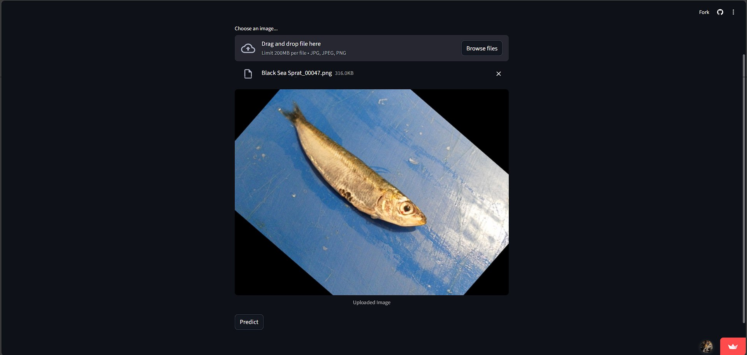
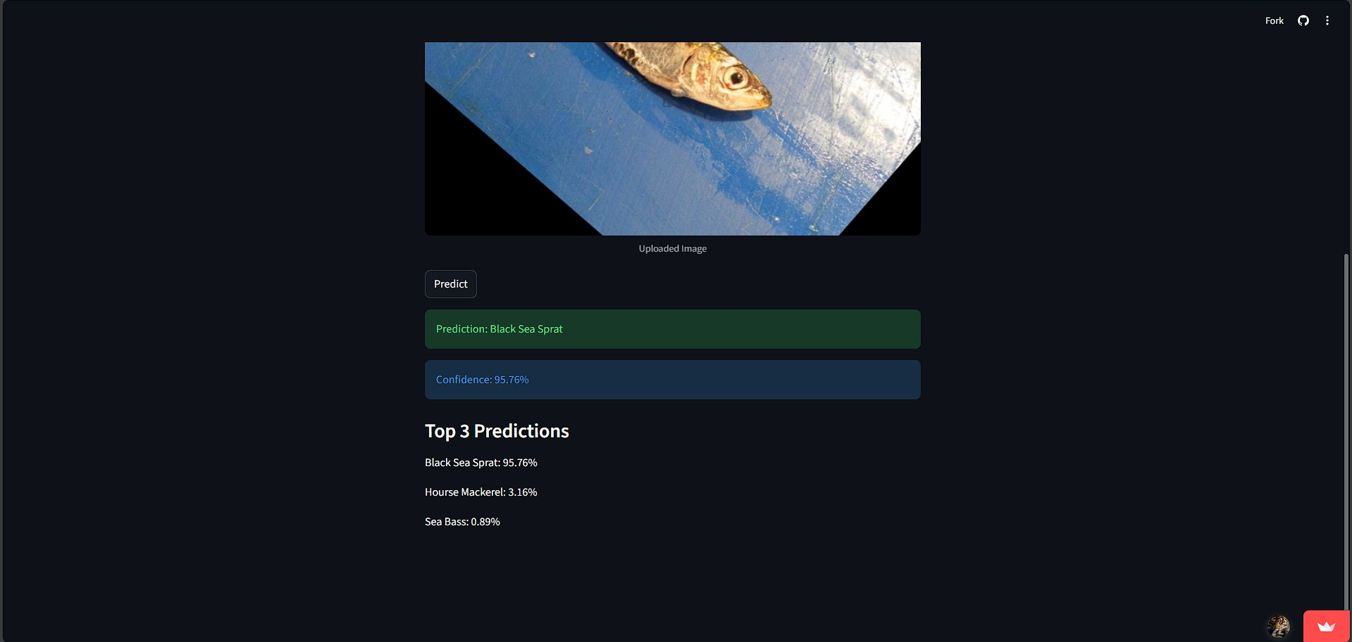

Streamlit Deployment Ui

Slide 15
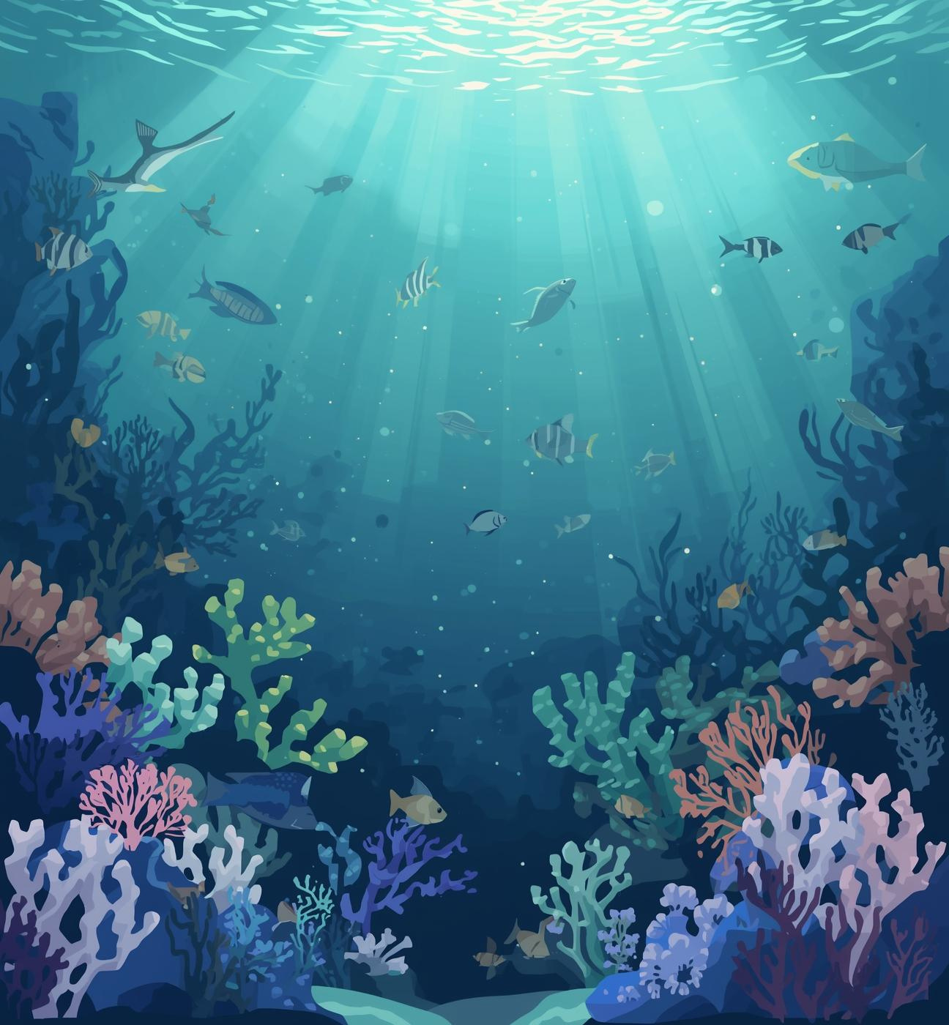

Conclusion
This project successfully demonstrates a full deep learning pipeline for fish species recognition, including:
EDA and data cleaning
Preprocessing and augmentation
Two modeling approaches (baseline CNN and Mobile Net transfer learning)
Evaluation using accuracy, classification report metrics, and confusion matrices
The final results show strong performance on the test set, and confusion matrices confirm that most predictions are correct with limited confusion mainly among visually similar species.

Slide 16


Thanks
Project Number:
9

